Slide 1

Spam Email Classification
Niranjana Kulkarni

Slide 2
Agenda
Problem Introduction
Data Description
Data Preparation
Models/Methodology
Results
Conclusion

Slide 3
Problem Introduction

Slide 4


Slide 5
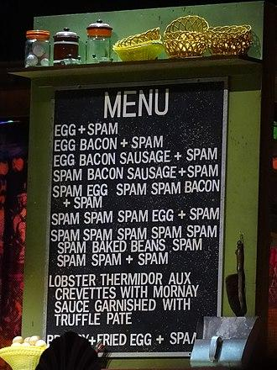
Why do we call emails “spam”?
In the comedy troupe TV series Monty Python, a group of Vikings sing a chorus of "SPAM, SPAM, SPAM..." at increasing volumes.
Now we refer to the phrase as unsolicited commercial electronic mail sent in bulk to different addresses
Notes:
The linguistic significance of the usage of the word 'spam' is attributed to the British comedy troupe Monty Python in a now legendary sketch from their Flying Circus TV series, in which a group of Vikings sing a chorus of "SPAM, SPAM, SPAM..." at increasing volumes,
We can see that the menu included spam in all their dishes because of the surplus of the good after WW2.
the historic significance lies in it being adopted to refer to unsolicited commercial electronic mail sent to a large number of addresses, in what was seen as drowning out normal communication on the internet.

Slide 6

Problem Introduction
Spam emails always has been troublesome in our inboxes.
What are the written indicators that an email is considered as spam in a workplace setting?
Many email platforms have their own automated systems to filter out such junk mails
Given relevant data, we can mimic such machine learning classification models and test the performance of our own models.
Notes:
Spam emails always has been troublesome in our inboxes.
What are the written indicators that an email is considered as spam in a workplace setting?
Many email platforms have their own automated systems to filter out such junk mails
Given relevant data, we can mimic such machine learning classification models and test the performance of our own models.

Slide 7

Data Source
Spam Email Indicators Data Source:
https://www.kaggle.com/datasets/somesh24/spambase?resource=download
57 predictor variables and one binary target variable
4601 rows and 58 columns
Notes:
Our data came from Kaggle.
57 predictor variables and one binary target variable
4601 rows and 58 columns
The data is a collection of spam emails which were extracted from Google Postmaster API for users.
All emails identified as spam have been flagged by users manually as spam.
The collection of non-spam e-mails in our dataset came from work and personal emails.
The collector of the data extracted non-spam emails from the workplace email account of a user named George working in the 650 area code.

Slide 8
Data Description
Notes:
Let us go into our data description.
(go to next slide)

Slide 9
Features
“Word” Frequencies (%)
Ex: the word “internet”
Character Frequency Variables (%)
Ex: the character “21”
Length Variables relate to the uninterrupted sequences of capital letters in the email
CRL_average = average length
CRL_longest = length of the longest sequence
CRL_total = total number of capital letters
Notes:
Out of the 57 predictor variables, we have 3 general types or variables:
“Word” Frequencies (48 variables), Character Frequencies (6 variables), and Length Variables (3 variables).
First we have word frequency variables. These are computed for each entry by finding
WF_internet is the percentage of the number of times the word “internet” appears in the entire email
CF_21 = the % of the number of times the character “21” appears in the entire email
Numerical values for frequencies in the dataset are the percentage numbers so instead of 0.25% we have 0.25 in our data.
(Go to next slide)
Side Notes:
“word” in this case is any string of alphanumeric characters bounded by non-alphanumeric characters or end-of-string such as “3internet123”

Slide 10
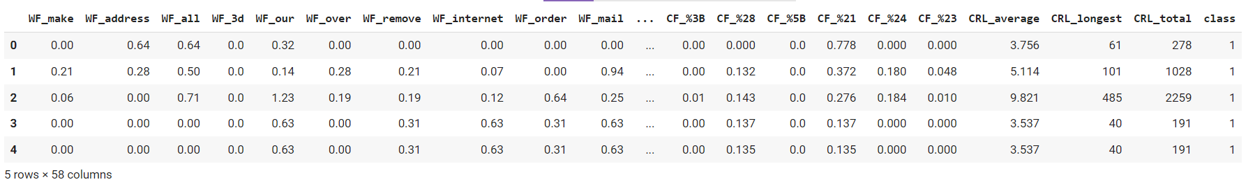
Initial Look at Our Dataset
We can see the first five entries of our data set as follows:
Notes:
Each row represents one email
We have the word and character frequencies and the uninterrupted sequences of capital letters in order here (point at the sections) already given for each email.
Our target variable (last column) is binary which is 0 if the email is not spam and 1 if the email is spam, so our first 5 entries are all spam emails
(go to next slide)

Slide 11
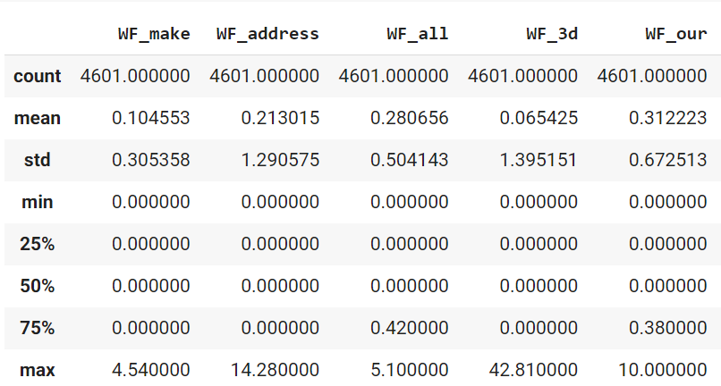
Checking our Data
No null/NA values in our dataset
Looked at descriptive statistics
Our data is sparse: 77.12% of our data is just zeros.
Notes:
Checking our data, we have no null/NA values in our dataset
Looking at descriptive statistics,
in this table below we can see for some word frequencies that our values are mostly close to 0 or are equal to 0.
We checked the sparsity of our data : 77.12% of our data is just zeros
(Go to next slide)

Slide 12
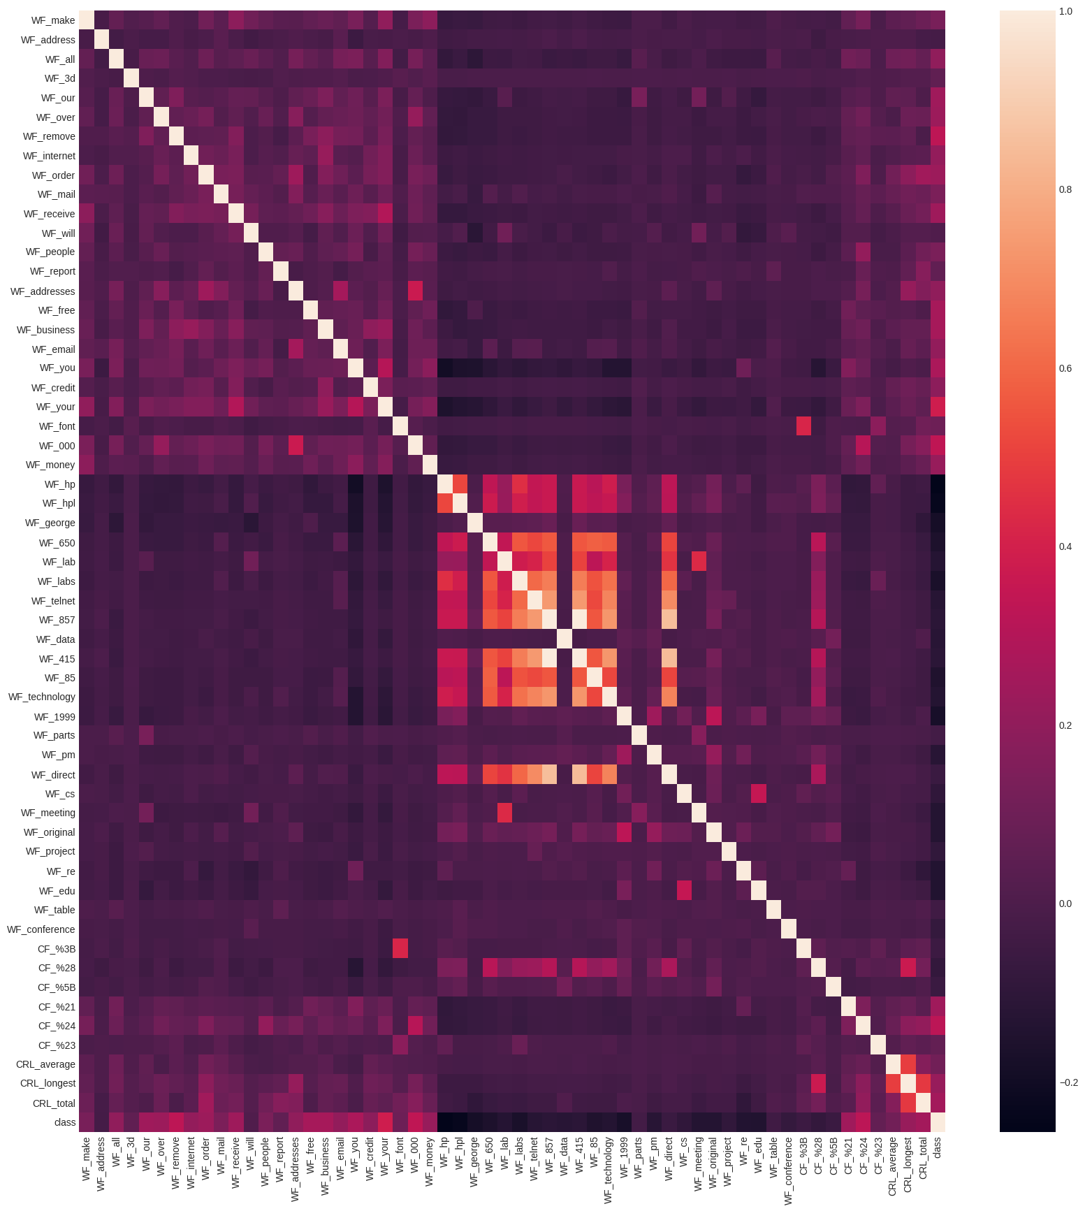
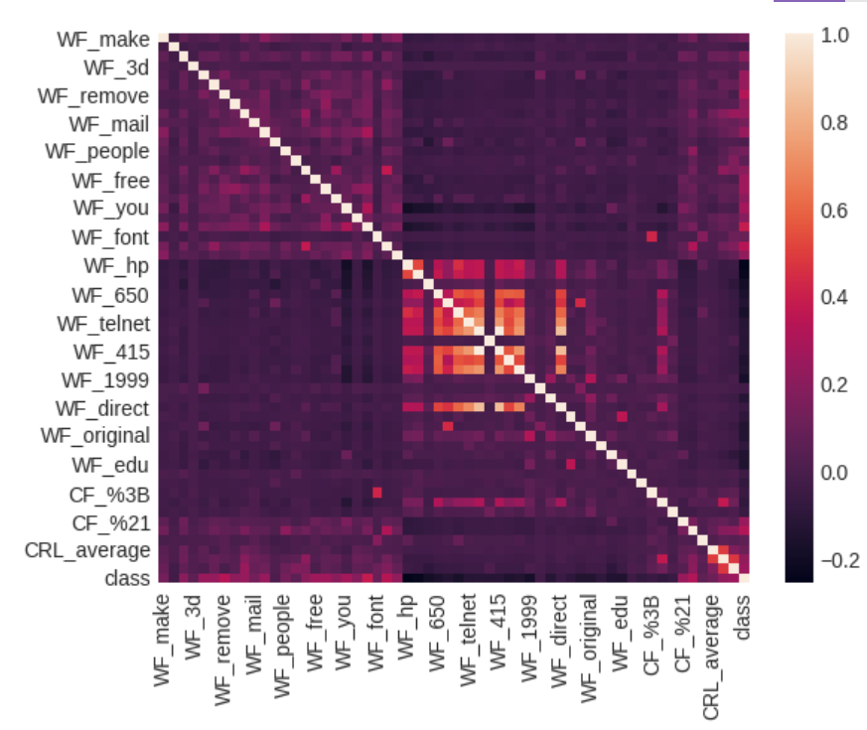
Heat Map (original data)
Notes:
We can see in this heat map with the variables being the axis that we have many variables that are positively correlated with each other,
(pointing)
as we can see by the central region and the bottom right of the heat map.
(go to next slide)

Slide 13
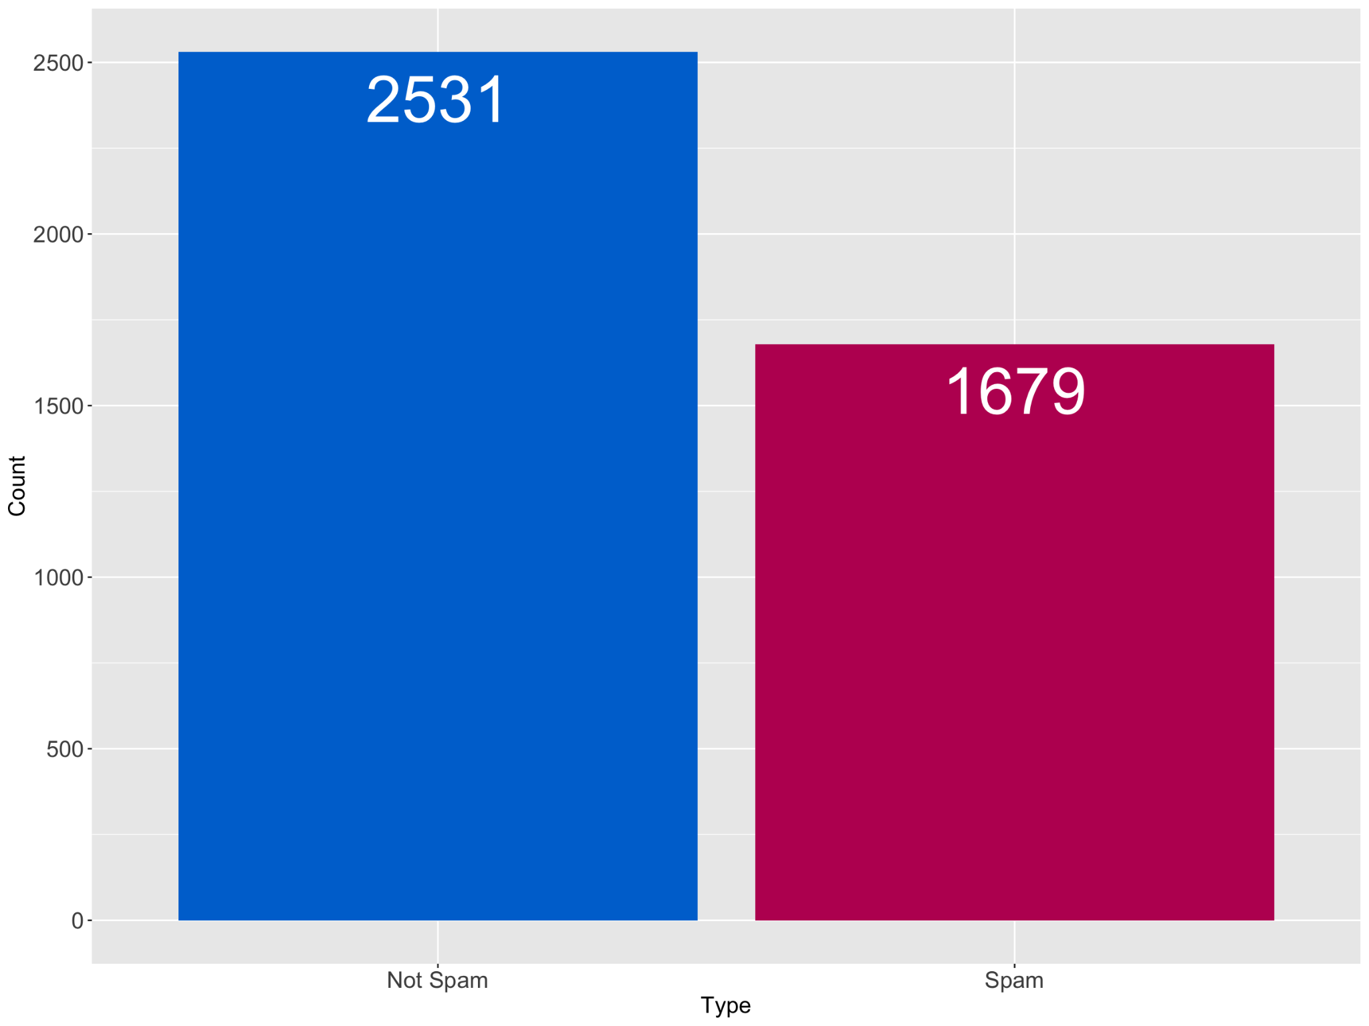
Proportion of target variable
Notes:
Out of the 4601 entries in our data set, we have about ⅔ of them are non-spam and about ⅓ are spam
(Go to next slide)

Slide 14
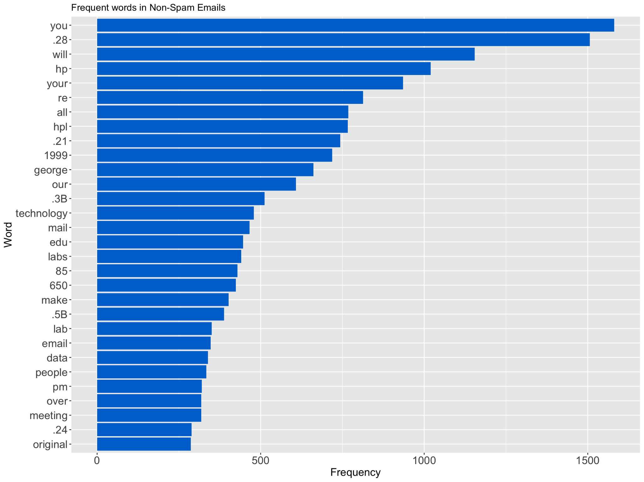
Frequent Phrases
in non-Spam emails
Notes:
This frequency plot for non-Spam emails show how often each phrase (including both word and character variables) appears in the sample of observations (email) as referenced before, we can see that the “george” and “650” are potential indicators of non-spam, as well as “hp” and “hpl”.
(go to next slide)
(when on this slide again)
as we can see near the top of the plots (point to the top and then)
(go to next slide)

Slide 15
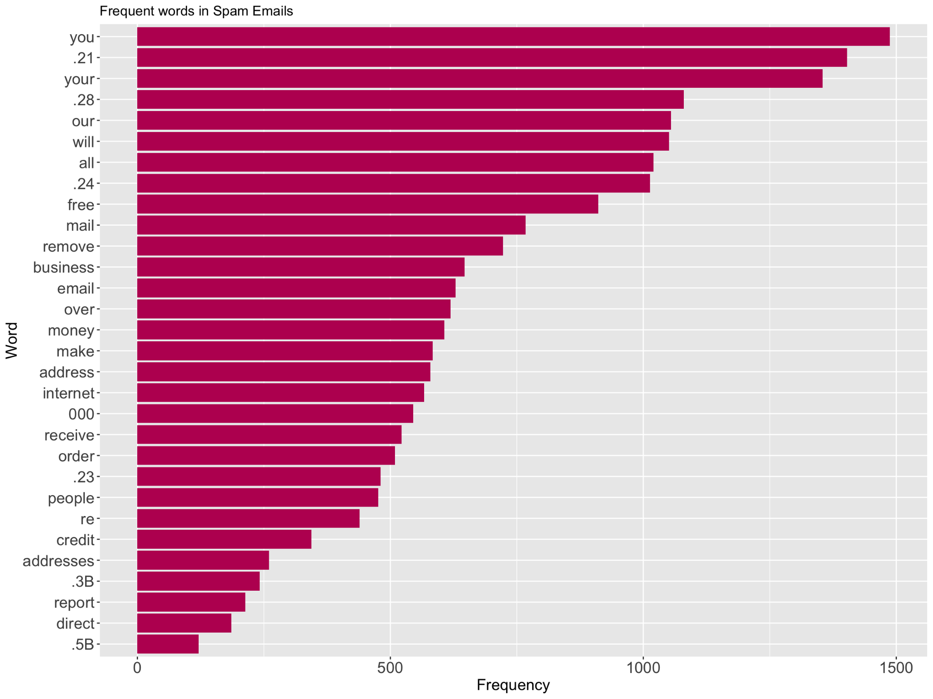
Frequent Phrases
in Spam emails
Notes:
This frequency plot for Spam emails is similarly created as the previous slide. We can see that the “free”, “business”, and “money” are potential indicators of spam. However, we can clearly see in both slides that “you”,”your” and “21” are frequently used in spam and non-spam (go to previous slide)
(when back on this slide again)
(point to the top of the plot here)
(go to next slide)

Slide 16
Data Preparation
Notes:
Now let us discuss how we prepared the data.
(Go to next slide)

Slide 17
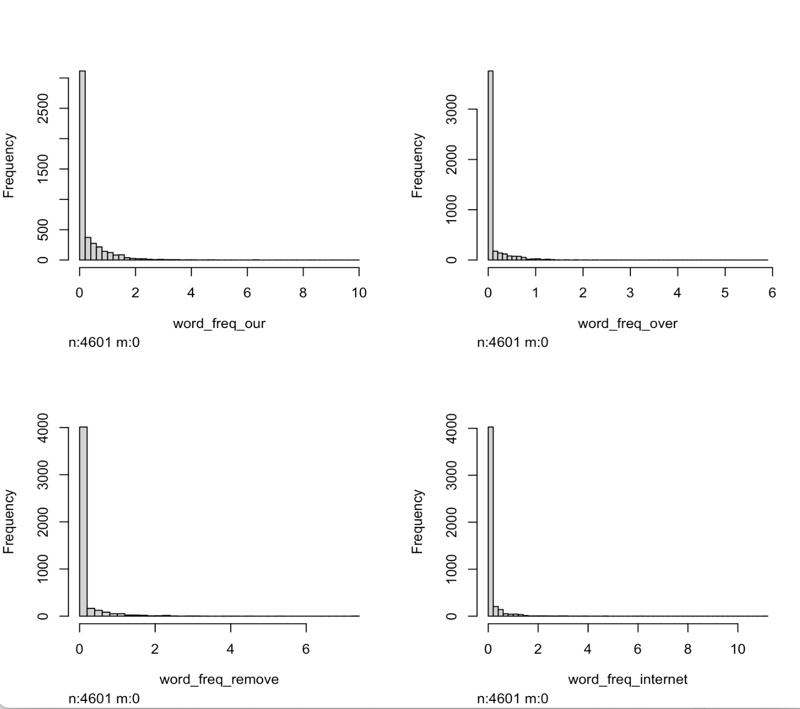
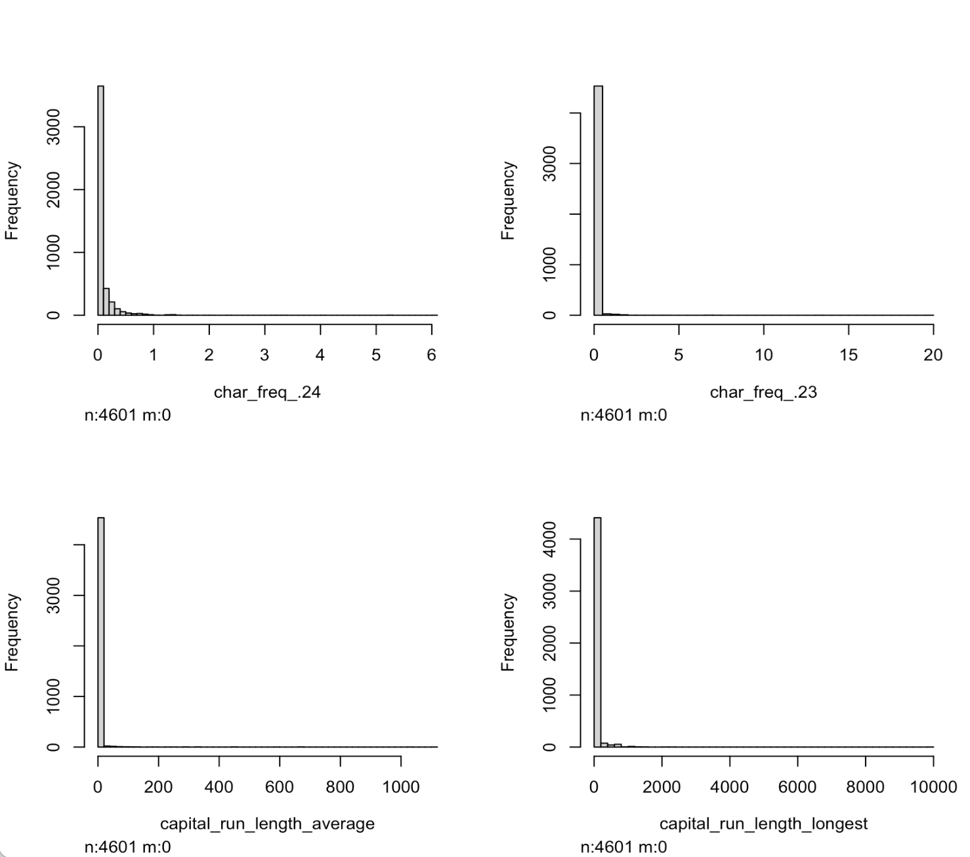
Data Preparation
Notes:
This is what the raw distribution of our data looks like.
(go to next slide)
(After going back to this slide)
We can see that for example these frequency variable histograms are zero-inflated and right-skewed and as we have seen before in the histogram that we have many variables that are highly correlated to each other.
(Go back to the next slide again)

Slide 18
Data Preparation
The original data set had many variables that are zero-inflated and right-skewed
Multicollinearity
Converted the original data set to a data set with binary variables
Then, transformations were performed on our data sets
Yeo-Johnson
Center and Scaling
Notes:
We can see that the original data set had many variables that are zero-inflated and right-skewed and we have many variables that are highly correlated to each other.
(go to previous slide)
(when back on this slide)
To combat this to some extent, we converted the original data set to a data set with binary variables
Then, we performed transformations on our data sets
Yeo-Johnson
( which increases low variance data and decrease high variance data to create a more uniform dataset)
Center and Scaling
How did we change the data set to binary?
(go to next slide)
Side Note: We also removed duplicates that were present in the original dataset, but in the case of the binary data set we did not need to remove them.

Slide 19
Defining a New Dataset
“Word” Frequencies become 0 or 1
Ex: the word “all”
Character Frequency become 0 or 1
Ex: the character “.5B”
Length Variables stay the same
Notes:
This is how we define our new data set:
“Word” Frequencies become 0 or 1
Character Frequency become 0 or 1
Length Variables stay the same
(Go to next slide)
Side note:
Numerical values for frequencies in the dataset contain the percentage number.

Slide 20
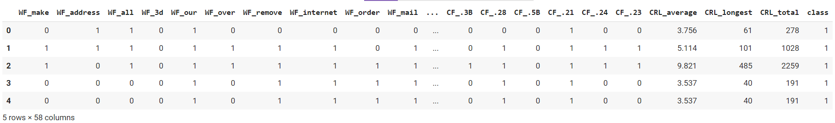
Changed Dataset
We can see the first five entries of our old data set as follows:
BINARY SUBSTITUTION
Notes:
For example we can see that the word “all” in the email entries, represented by column 3
(POINT)
and the character “21” represented by the 3rd last column in the box
(POINT)
change from 0.64% and 0.778% in the first row
to 1 in our new dataset (POINT) because the frequency of the phrase in the email is nonzero.
Now after preparing the data, we can construct models or methods to deal with the data.
(Go to next slide)

Slide 21
Models

Slide 22
Models Created
Stepwise Linear Regression
PCA with Logistic Regression
Logistic Regression
Elastic Net Logistic Regression
Naive Bayesian
KNN
Notes:
These are our models

Slide 23
Stepwise Linear Regression
Iteratively adds and removes the predictors based on their significance to the overall model
Determines how dependent the variables are and cuts down on number of features
Requires high computing power and has inherent bias
Potential of overfitting
Notes:
Iteratively adds and removes the predictors based on their significance to the overall model
Determines how dependent the variables are and cuts down on number of features
Requires high computing power and has inherent bias
Potential of overfitting

Slide 24
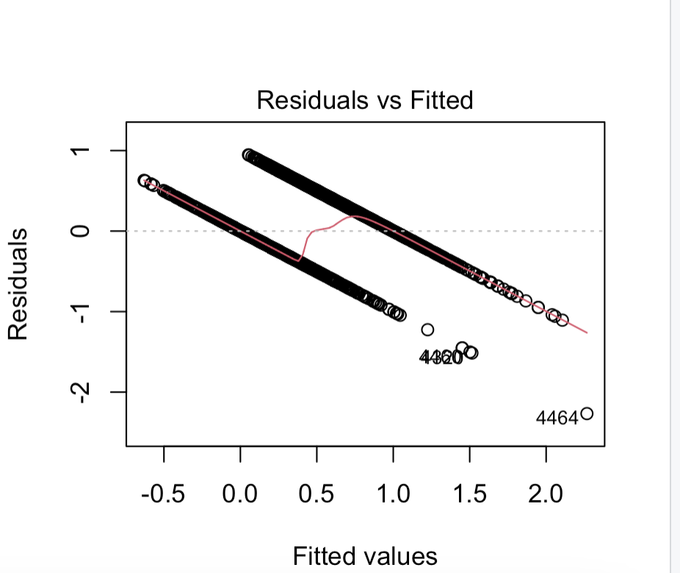
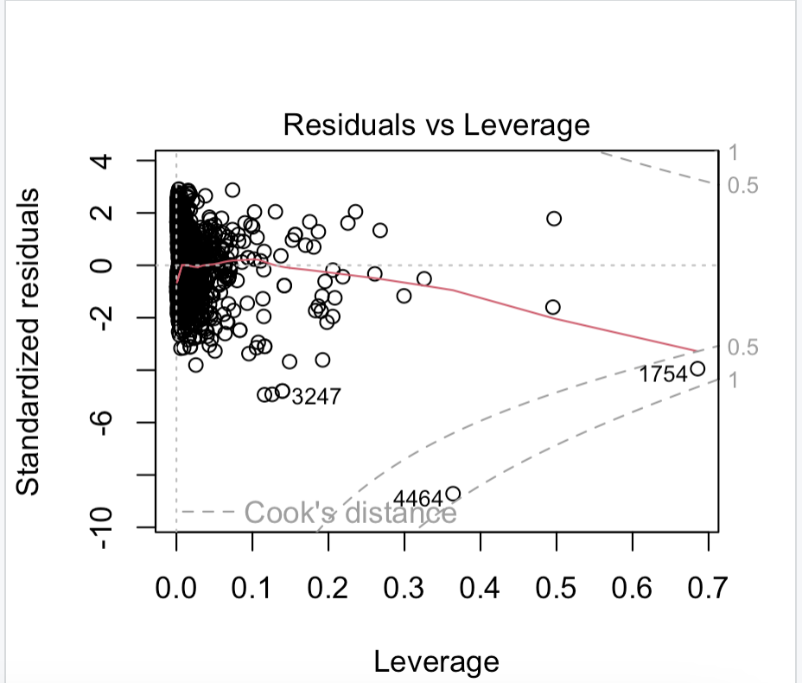
Stepwise Linear Regression (Original data)
A stepwise linear regression(both directions) resulted in a model with an AIC of -10264
46 predictors were kept
Adjusted R-squared value is 0.5547
Model utility test yielded a p-value of near 0
Notes:
A stepwise linear regression resulted in a model with an AIC of -10264
46 predictors were kept
Adjusted R-squared value is 0.5547
Model utility test yielded a p-value of near 0
Diagnostic plots detected nonlinearity, unequal variances

Slide 25
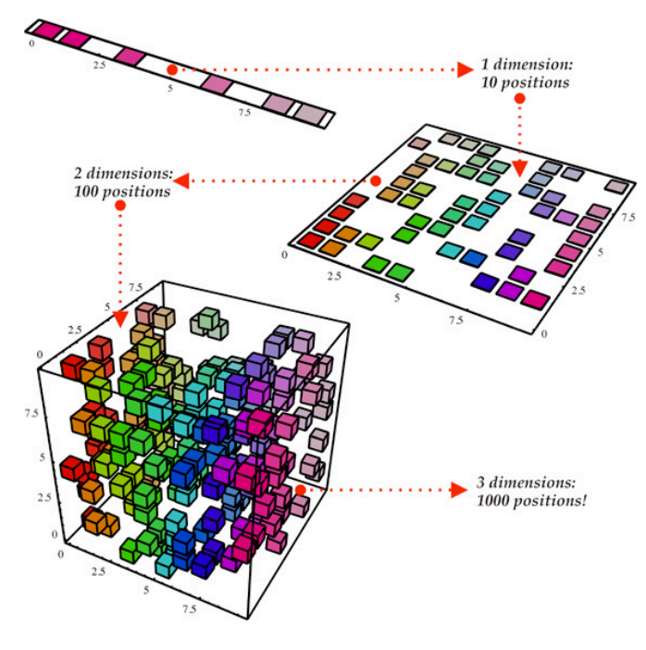
Principal Component Analysis
Principal Component Analysis is used for high dimensional analysis for dealing with sparse matrices
PCA creates “components” which are a linear combination of variables in the data set
Using these components we can make future analysis simpler
(Not our data set!)
Notes:
Nira
Principal Component Analysis is used for high dimensional analysis for dealing with sparse matrices
What PCA does is that it creates “components” which are a linear combination of variables in the data set so these components capture the variance between variables of the original data set
Using these components we can make future analysis simpler such as using these components in Logistic Regression.
It is much easier to visualize data when we can look at a simpler looking form of the data as we can see in this picture to the left (POINT) when we go from 3 dimensions to 2
Now how do we know how many components are the best for our data?
(go to next slide)

Slide 26
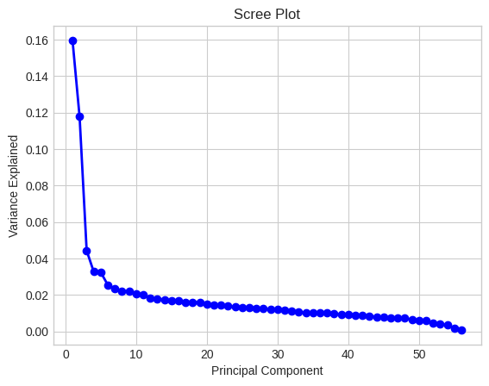
Scree\Elbow Plot (Original Data with YJ)
A Scree Plot is a tool we use in order to determine how many components to use to encompass more of the dataset’s variance.
We will use 4 PCA components.
However, we will still keep 2 PCA components in mind.
Notes:
A Scree Plot is a tool we to use determine how many components are the best for our data by showing how much variance is explained by adding another component.
(POINT AT THE PLOT)
From this plot, we can see that where the plot turns sharply, (or the “elbow”)
(POINT AT THE ELBOW) allows us to add components that to represent more of the variance without adding too many components. This sweet spot (POINT AT YELLOW CIRCLE) related to our dataset is 4 components. For the purposes of this data set we will perform PCA with 4 components (circled in yellow) and PCA with 2 components (boxed in yellow POINT AT BOX) which we do in order to visualize our results better
(go to next slide)

Slide 27
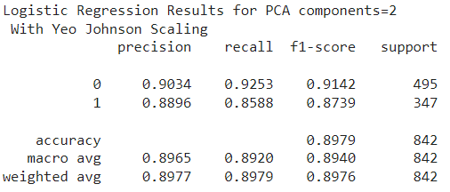
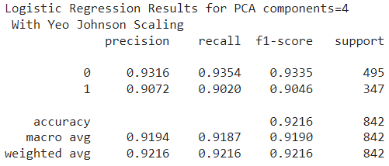
PCA with Logistic Regression Accuracy (YJ)
Logistic Regression with 2 Components
Confusion Matrix (2)
 | TP | TN
PP | 458 | 37
PN | 49 | 298
Logistic Regression with 4 Components
Confusion Matrix (4)
 | TP | TN
PP | 463 | 32
PN | 34 | 313
Notes:
In dealing with the original dataset, we chose to perform Yeo-Johnson scaling on the data before Computing the accuracy we can see that performing PCA with 4 Components gives us a much higher accuracy than PCA with 2 Components. Additionally our confusion matrices on the right (POINT) shows us that Logistic Regression with 4 components is much better than 2 Components.
(go to next slide)

Slide 28
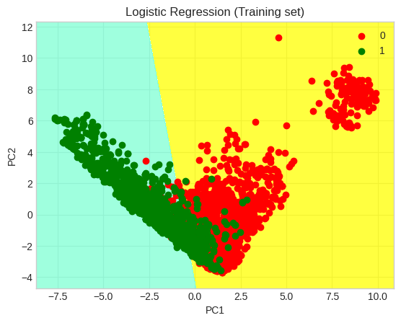
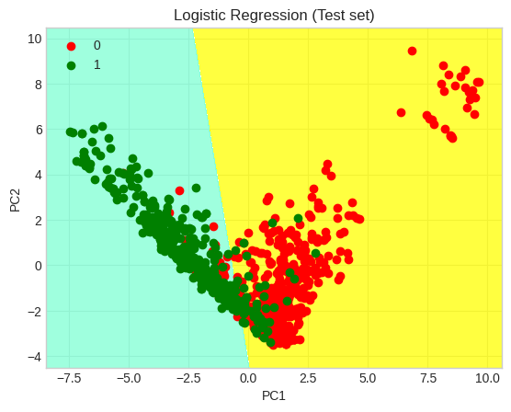
Logistic Training vs. Testing Plots
Training data: 80%, Test data: 20%
Notes:
These plots show us how PCA with two components with randomly selecting 80% of the entries being training data and 20% of the entries being testing data.
We can see that the overlap between the red and green points in the testing and training plots shows us some issues in the model.
(Side Note) (ONLY IF QUESTIONS)
In the future we can look at the points when this overlap happens as well as outlying points to construct more accurate models.

Slide 29
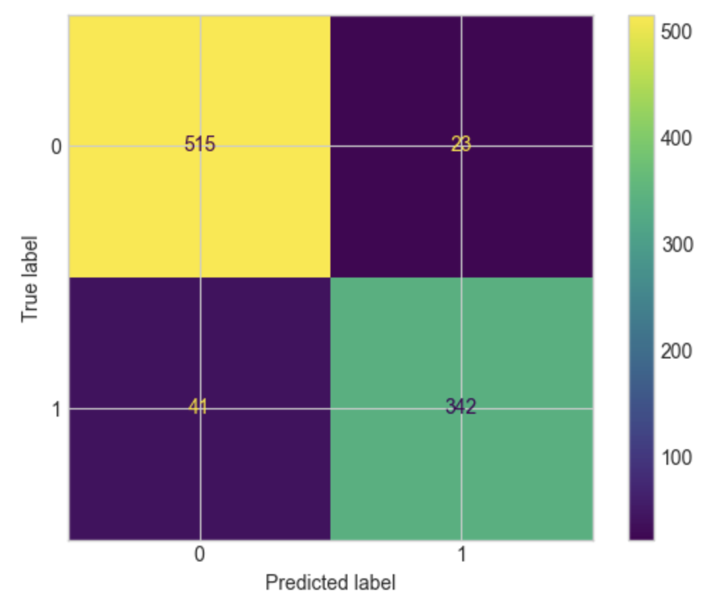
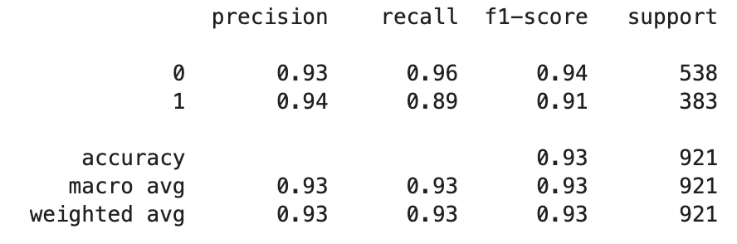
Logistic Regression
Using Binary Transformed Dataset
Sklearn in Python
Training data: 80%, Test data: 20%
Accuracy is 93%
Notes:
Using Binary Transformed Dataset
Sklearn in Python
Training data: 80%, Test data: 20%
Accuracy is 93%
Classification Report and Confusion Matrix

Slide 30
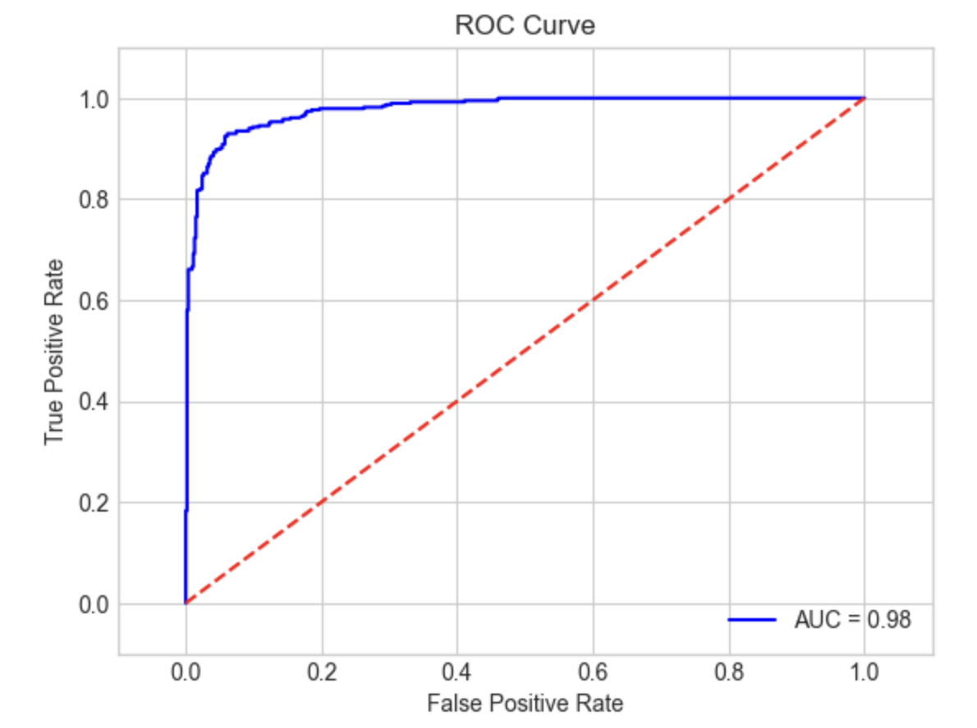
Logistic Regression
Area under the curve is very close to 0.98
Notes:
ROC curve is top left with area under the curve 0.98
Effective model

Slide 31
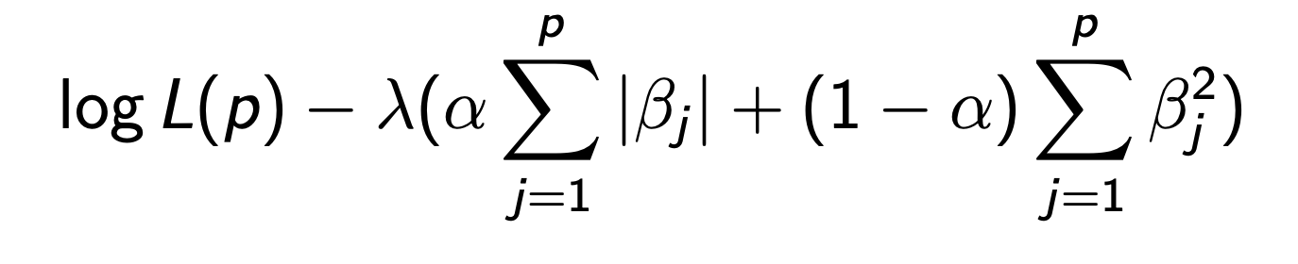
Elastic Net Regression (Binary Data)
A regression method with penalization on the loss function
Combination of Ridge and Lasso penalization
Log Likelihood
Lasso term
Ridge term
Notes:
Extending from ordinary Logistic reg., Elastic Net = simply a penalized version of linear/logistic regression
The penalty is added to the loss function (log likelihood in case of logistic reg.) as you can see on the formula
The penalization method includes Ridge and Lasso terms. Ridge utilizes L2 norm of the regression coefficients and Lasso utilizes L1 norm.
Elastic Net has a penalization that uses both Ridge and Lasso penalties. The two terms are proportionally combined by alpha and multiplied by lambda
We need to estimate two additional parameters lambda and alpha
Lambda determines the strength of penalization and alpha assigns the proportion of the two penalty terms

Slide 32
Elastic Net Regression
Elastic Net regression is often used for :
Identifying features that are related to the supervisor
Penalization can set some coefficients of predictors to be zero
Manages highly correlated predictors
Allows to exchange some bias for lower variance
We applied Elastic net regression in order to see if any improvements occur with penalization.
Parameters (lambda and alpha) are estimated using 10 fold cross-validation.
Notes:
Elastic Net regression is often used for :
Identifying features that are related to the supervisor
Penalization can change coefficients of predictors and even zero them out
Which means it can perform dimensional reduction as well
Manages highly correlated predictors
Allows to exchange some bias for lower variance
We applied Elastic net regression along with ridge/lasso regression in order to see if any improvements occur with penalization.
Parameters (lambda and alpha) are estimated using 10 fold cross-validation.

Slide 33
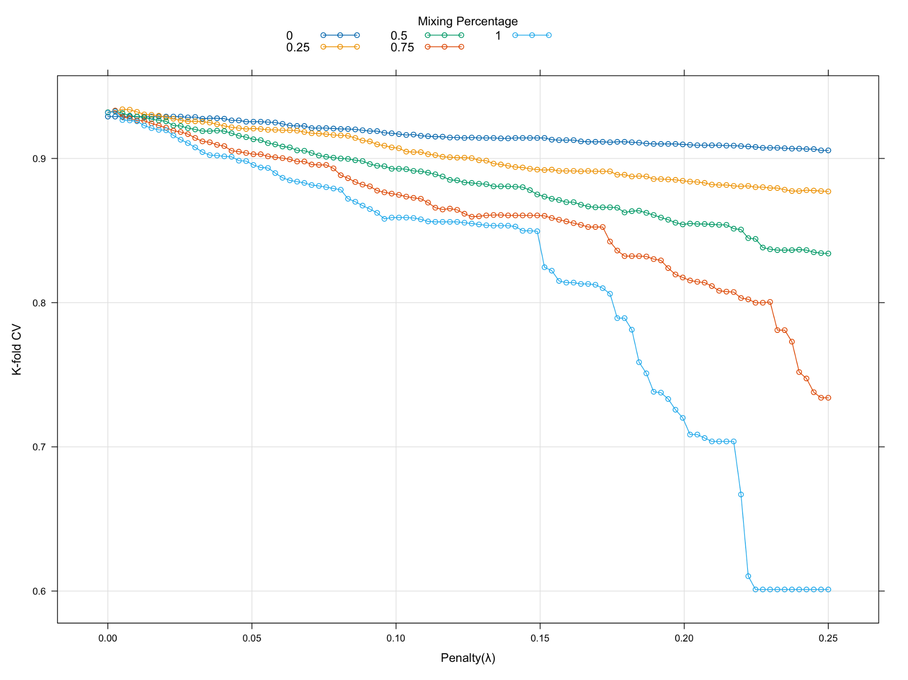
Parameter Estimation
Cross-validation estimated the optimized parameters to be :
α = 0.25
λ = 0.00505
lambda is very close to zero. This tells us that penalization does not improve the fit.
Notes:
From the cross validation, we estimated alpha = 0.25 and lambda = 0.005
The plot shows the performance of different alpha and lambda combinations
We can see that the optimal estimates are located on the very top left.
We observe that, when lambda is small, there is not much accuracy difference among alpha values.
And our lambda was estimated to be very close to zero. This tells us that penalization does not improve the fit significantly.

Slide 34
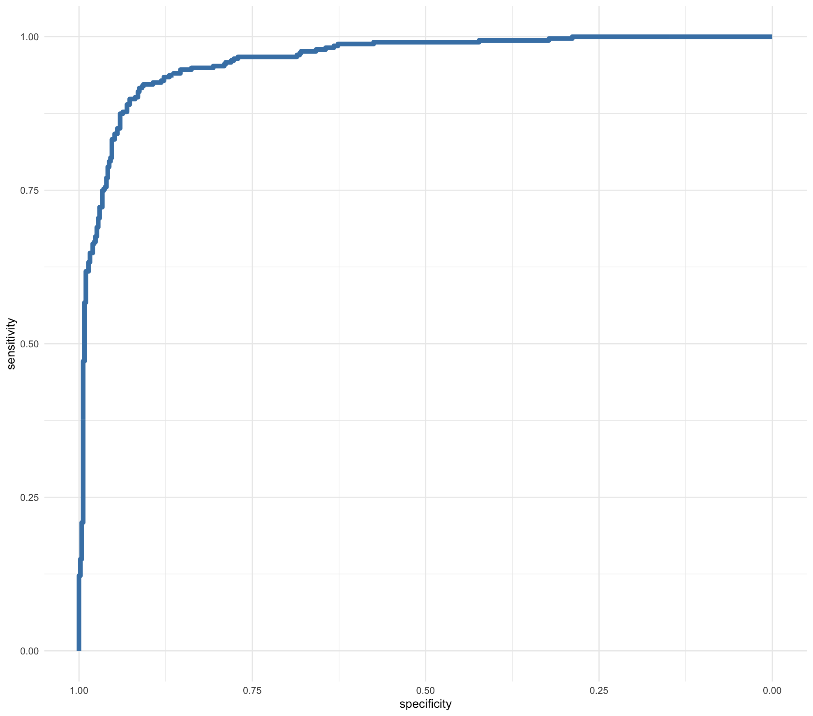
Accuracy: Elastic Net
Accuracy :
0.9246017
Area under the roc curve :
0.9783
Precision :
0.9402516
Recall :
0.8925373
F1 Score :
0.9157734
Notes:
This is also reflected in the performance of model
These are different criteria for determining model performance.
The accuracy is 0.92.
Precision, Recall, F1 score fall within similar range
While the model is performing well,
Elastic net is not really performing any better than ordinary logistic regression. This is because our optimized lambda value was close to zero,
Meaning there is really no effect of penalization
Therefore, elastic net resulted in only over-complicating the model, so we would prefer ordinary logistic regression model over this

Slide 35
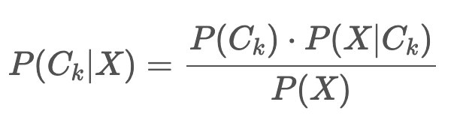
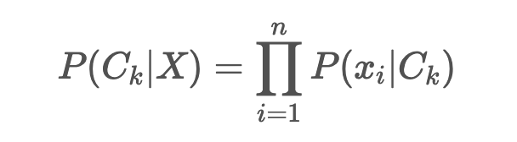
Naive Bayes
Naive Bayes classifier utilizes Bayes theorem :
Assuming conditional independence of predictors, the posterior distribution can be simply expressed by product of probability distribution of each predictor conditioned on the response category.
We fit Naive Bayesian classifier by preprocessing the predictors with standardization and PCA. We assume conditional independence.
Notes:
The Naïve Bayes classifier is a simple probabilistic classifier which is based on Bayes theorem
Assuming conditional independence of predictors,
the posterior distribution can be simply expressed by the product of conditional probability distribution of each predictor given response category.
The reason why this method called ‘naive’ is because it requires a very strong and most likely unrealistic assumption,
which is conditional independence of all predictor variables.
In order to meet this requirement, we fit Naive Bayesian classifier with preprocessed predictors with standardization and PCA. With these, we assumed conditional independence.

Slide 36
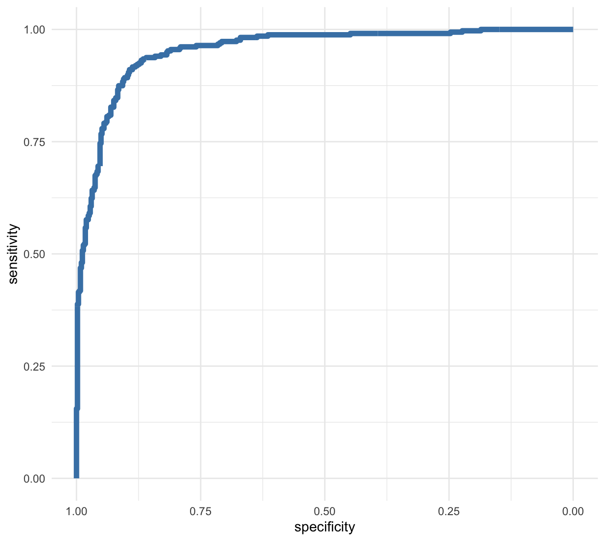
Accuracy: Naive Bayes
Accuracy :
0.8941736
Area under the roc curve :
0.954
Precision :
0.8617647
Recall :
0.8746269
F1 Score :
0.8681481
Notes:
We observe that the overall performance criterias are quite low.
Accuracy is below 0.9, and ROC curve also shows smaller area under curve compared to the previous models.
This could indicate that our assumptions of conditional independence did not meet very well

Slide 37
KNN (K-Nearest Neighbors)
The KNN algorithm relies on the idea that similar data points tend to have similar labels or values.
Using a distance metric such as Euclidean distance, the model identifies the K nearest neighbors and predicts the supervisor label of new data as the most common class label among the K neighbors.
Very susceptible to the curse of dimensionality
Our dataset is high-dimensional, which means KNN method could be computationally expensive and slow. With this in mind, we operated 10-fold cv to estimate K.
Notes:
The K-Nearest Neighbors (KNN) algorithm relies on the idea that similar data points tend to have similar labels or values.
Using a distance metric (in our case, Euclidean distance), the model identifies the K nearest neighbors and predicts the supervisor label of new data to be the most common class label among the K neighbors.
Because this method involves distance metric, it is very susceptible to the curse of dimensionality.
Our dataset contains about 50 predictors, which is high-dimensional, so the method was slow and computationally expensive.
We operated a 10-fold CV to estimate K.

Slide 38
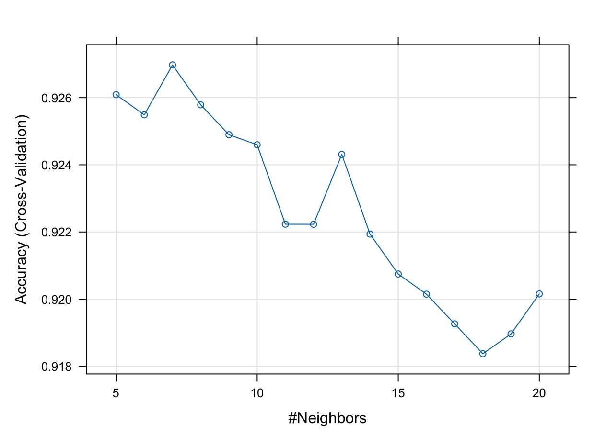
Parameter Estimation
Cross-validation estimated the optimized K = 7
Notes:
We found that using 7 nearest neighbors would provide the best performance when using KNN classification
Considering dimensionality, it seems like 7 neighbors is quite a small number, but we see that the prediction rate decreases as k increases.

Slide 39
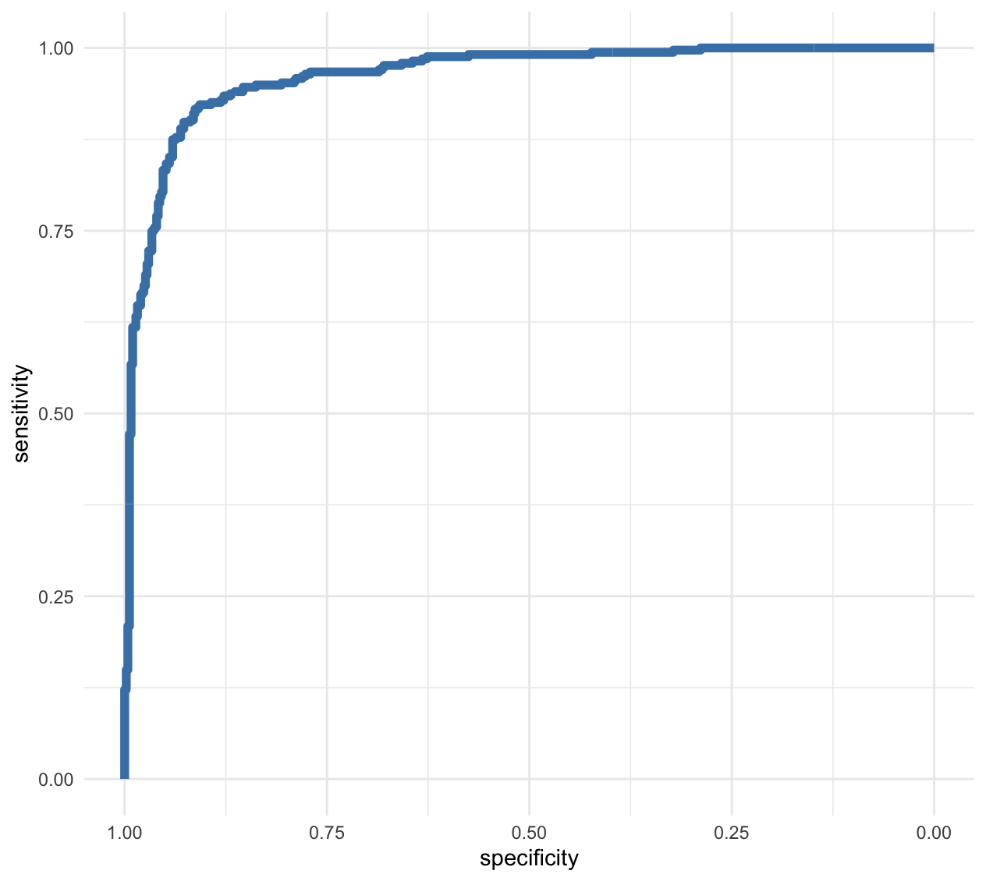
Accuracy: KNN
Accuracy :
0.9357907
Area under the roc curve :
0.9667
Precision :
0.9266055
Recall :
0.9014925
F1 Score :
0.9151515
Notes:
KNN showed the highest accuracy among all models so far with accuracy of 0.935. This is quite close to logistic regression and elastic net

Slide 40
Results/Best Models
Models | Accuracy
Logistic Regression (BD) | 0.93
Elastic Net (BD) | 0.9246017
KNN (BD) | 0.9357907
Naive Bayes (BD) | 0.8941736
PCA with Logistic Regression (OD) | 0.9216
Notes:
Comparing our models, we see that the model with the highest accuracy is K-Nearest Neighbors method for our Binary Transformed Data Set.

Slide 41
Comparing Confusion Matrices
Logistic Regression
Logistic with PCA (4)
Elastic Net Logistic Reg.
 | TP | TN
PP | 515 | 23
PN | 41 | 342
 | TP | TN
PP | 463 | 32
PN | 34 | 313
 | TP | TN
PP | 299 | 19
PN | 36 | 487
KNN
Naive Bayes
 | TP | TN
PP | 303 | 24
PN | 32 | 482
 | TP | TN
PP | 269 | 49
PN | 66 | 457
Notes:
Here are our confusion matrices for our methods we used. Now let us discuss the conclusions.

Slide 42
Conclusions
Overall, the spam email classification dataset required transformations, such as Yeo-Johnson, Center and Scaling, and Binary Transform.
The many categorical predictors lend themselves useful in simpler models, such as Logistic Regression with and without PCA, but also more complex classifiers, such as Naive Bayes and K-Nearest Neighbors. KNN was the most effective.
The second most accurate models were the ordinary Logistic Regression with the Binary Transformed dataset and extensions, such as Elastic Net. Logistic Regression with PCA on the original dataset was not as accurate.
Notes:
Overall, the spam email classification dataset required transformations, such as Yeo-Johnson, Center and Scaling, and Binary Transform.
The many categorical predictors lend themselves useful in simpler models, such as Logistic Regression with and without PCA, but also more complex classifiers, such as Naive Bayes and K-Nearest Neighbors. KNN was the most effective.
The second most accurate models were the ordinary Logistic Regression with the Binary Transformed dataset and extensions, such as Elastic Net. Logistic Regression with PCA on the original dataset was not as accurate.

Slide 43
Future Applications
Businesses and the corporate world need to have applications that can filter out spam emails and decipher phishing schemes that will harm infrastructure and revenue.
Gathering more data, such as IP addresses, and records on the number of times a spam email is sent can aid in making these spam filters more accurate and personalized to the recipient.
Large language models and deep learning can also be utilized to streamline the classification of emails from sources that may not be trustworthy.
Notes:
Businesses and the corporate world need to have applications that can filter out spam emails and decipher phishing schemes that will harm infrastructure and revenue.
Gathering more data, such as IP addresses, and records on the number of times a spam email is sent can aid in making these spam filters more accurate and personalized to the recipient.
Large language models and deep learning can also be utilized to streamline the classification of emails from sources that may not be trustworthy.

Slide 44

Thanks!

Slide 45
Sources
Definition of Spam
https://en.wikipedia.org/wiki/Email_spam
History of the phrase “Spam”
https://en.wikipedia.org/wiki/History_of_email_spam
Reference for Logistic Regression
https://scikit-learn.org/stable/modules/generated/sklearn.linear_model.LogisticRegression.html
Spam Email Indicators Data Source:
https://www.kaggle.com/datasets/somesh24/spambase?resource=download
KNN Overview:
https://www.analyticsvidhya.com/blog/2018/03/introduction-k-neighbours-algorithm-clustering/#:~:text=The%20K%2DNearest%20Neighbors%20(KNN)%20algorithm%20is%20a%20popular,training%20dataset%20as%20a%20reference.
Naive Bayes Overview
https://www.ibm.com/topics/naive-bayes#:~:text=Naïve%20Bayes%20is%20part%20of,important%20to%20differentiate%20between%20classes
PCA Overview
https://www.geeksforgeeks.org/principal-component-analysis-pca/

